Slide 1
IoT-Based Real-Time Underground Gas Pipeline Fault Detection and Alert System
Objective: Develop an IoT-based real-time underground gas pipeline fault detection and alert system.
Research-Based Justification
Kumar & Patel (2021): IoT-based gas leakage detection enhances safety through real-time sensor monitoring.
Zhao & Wang (2020): Wireless Sensor Networks (WSN) improve gas pipeline fault detection and data transmission efficiency.
Singh & Gupta (2019): GSM and GPS-based fault alert systems enable quick responses and precise location tracking.
Limitations:
Periodic Manual Inspections – Delayed fault detection, increasing risks.
Basic Sensor-Based Alarms – Lack of real-time monitoring & response mechanism.
Wired Networks – High cost and impracticality, especially for underground pipelines.

Slide 2

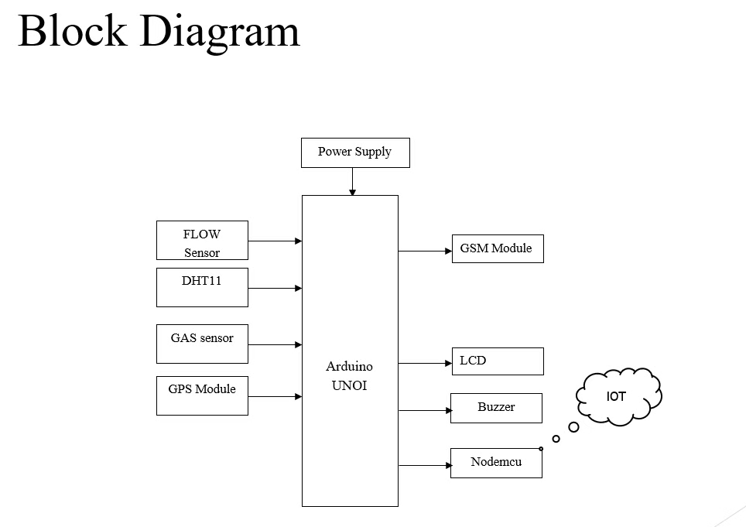






System Overview and Components
Sensors
Detect gas leaks, flow rate changes, and temperature variations.
Microcontroller
Arduino processes data from sensors.
GSM Module (SIM800L)
Sends SMS alerts when threshold values exceed.
GPS Module (NEO-6M)
Captures and sends the fault location.
IoT Dashboard
ThingSpeak logs and displays real-time sensor data.
Automatic Shutoff Mechanism
A relay triggers a solenoid valve to stop gas flow.

Slide 3
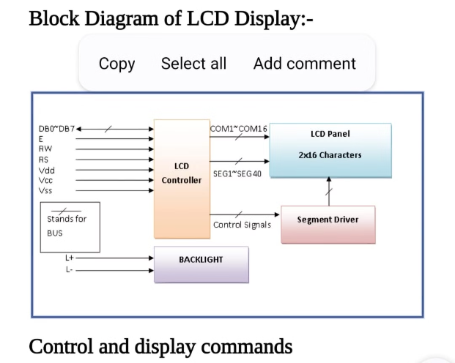
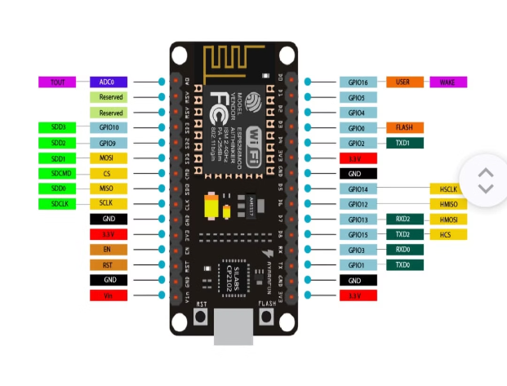
Hardware: Block Diagram & Architecture
NodeMCU ESP32 in the System
LCD Display
The NodeMCU ESP32 acts as the central controller, reading sensor data and transmitting it to the ThingSpeak cloud for real-time monitoring. It triggers a buzzer alarm, sends SMS alerts with GPS location, and enables seamless remote monitoring via Wi-Fi and GSM, ensuring efficient and automated pipeline safety.
The LCD display provides real-time updates on sensor readings, including gas levels, temperature, humidity, and flow rate. It also displays fault alerts, ensuring on-site operators receive immediate visual notifications for quick action.

Slide 4
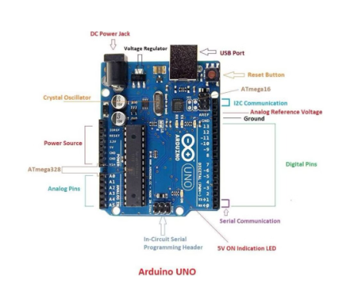
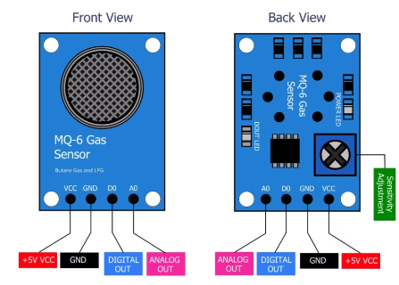
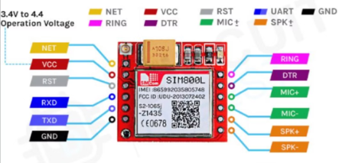
Hardware: Block Diagram & Architecture
SIM800L GSM Module
The SIM800L GSM module enables wireless communication by sending SMS alerts to operators when a fault is detected. Integrated with NodeMCU ESP32, it transmits fault details, including gas leaks, temperature anomalies, or flow rate issues, along with a Google Maps link for precise location tracking using GPS data.
MQ-6 Gas Sensor
Arduino Uno
The MQ-6 gas sensor detects LPG, butane, and propane leaks, sending data to NodeMCU ESP32. If gas levels exceed safe limits, it triggers buzzer alerts, LCD warnings, and SMS notifications for quick response.
The Arduino Uno processes sensor data and communicates with the NodeMCU ESP32 for real-time monitoring. It manages the LCD display, buzzer alerts, and GSM module, ensuring efficient fault detection and quick notifications for pipeline safety.
This ensures immediate notifications, allowing quick response and enhancing pipeline safety.

Slide 5
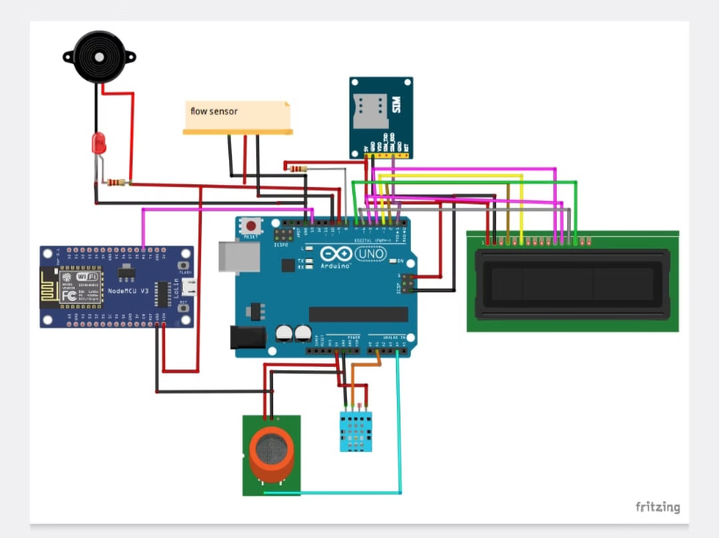
Circuit Diagram
The circuit integrates NodeMCU ESP32, various sensors (gas, temperature, humidity, and flow rate), an LCD display, a GSM module, a GPS module, and a buzzer for real-time gas pipeline monitoring.
Key Connections:
Sensors → ESP32 for continuous data collection.
LCD Display → Shows real-time sensor values and alerts.
GSM & GPS Modules → Sends SMS alerts with fault location.
Buzzer → Activates during fault detection.
ESP32 → ThingSpeak Cloud for remote monitoring and visualization.

Slide 6











Hardware Components
Arduino UNO
MQ-6 Gas Sensor
DHT11 Sensor
Central microcontroller for sensor integration.
Detects gas leaks (butane, methane, propane).
Measures temperature & humidity variations.
Flow Sensor
SIM800L GSM Module
NEO-6M GPS Module
Detects flow rate anomalies in the pipeline.
Sends SMS alerts in case of faults.
Provides accurate location tracking of the fault.
NodeMCU ESP8266
LCD Display
Buzzer
Connects the system to ThingSpeak for IoT monitoring.
Shows real-time data for on-site monitoring.
Alerts nearby personnel during gas leaks.
Relay & Solenoid Valve
Power Supply
Automatically shuts off gas supply when a fault is detected.
12V Adapter / Solar Panel + Battery provides continuous power.

Slide 7
Impact & Proposed System Overview
Impact of the System
Real-time monitoring ensures continuous tracking of gas pipeline status.
Automated fault alerts enable instant notifications to prevent hazards.
Early detection significantly reduces the risk of accidents.
Faster response time enhances safety and operational efficiency.
Proposed System Overview
Real-time detection using sensors and microcontrollers for fault identification.
GSM and GPS-based alert system for quick fault notifications and location tracking.
Cloud-based IoT dashboard for centralized remote monitoring in the control room.
Automated shutoff mechanism to prevent gas leaks and enhance safety.

Slide 8
Software Components & Data Transmission
Software Components
Real-time Data Transmission
ThingSpeak Dashboard (Control Room Monitoring)
Arduino IDE – Used for programming and sensor interfacing.
Sensors (MQ-6, Flow, DHT11) measure real-time parameters.
Plots gas level, temperature, and flow rate graphs.
Arduino UNO processes sensor readings.
Embedded C programming – Controls sensor data processing & GSM alerts.
Displays real-time alerts when thresholds are exceeded.
NodeMCU ESP8266 transmits data to the ThingSpeak cloud via Wi-Fi.
Enables historical trend analysis for predictive maintenance.
ThingSpeak IoT Dashboard – Visualizes gas, temperature, and flow rate data.

Slide 9
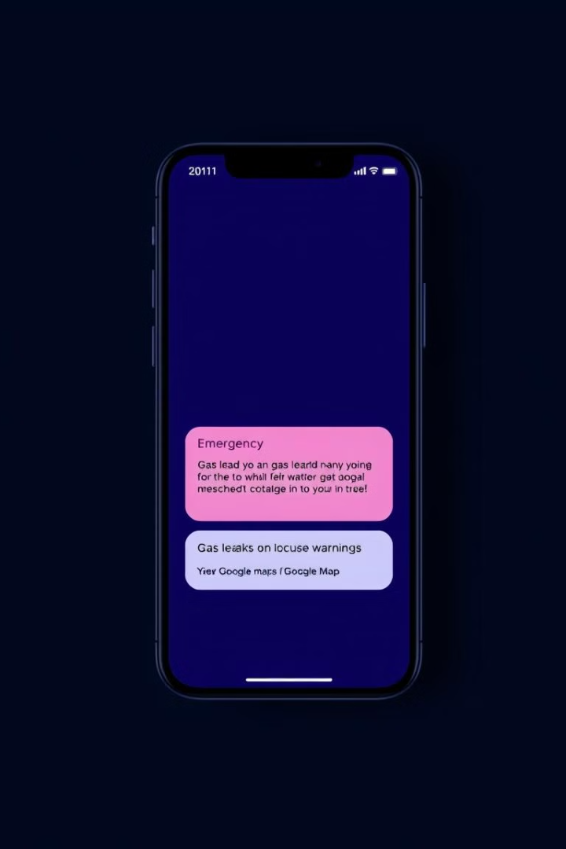
GPS & GSM Alert Mechanism
Sensor Detects Anomaly
Gas leak, temperature rise, or abnormal flow is detected by sensors.
Arduino Triggers GSM Module
Arduino activates SIM800L GSM Module to send an SMS alert.
GPS Provides Location
NEO-6M GPS Module determines precise fault location coordinates.
SMS Alert Sent
Alert includes issue type and Google Maps link to fault location.
Example SMS Alert: "Gas Leak Detected! Location: [Google Maps Link]"

Slide 10
Arduino Code – Sensor Integration & Alert System
Code Functionality
#include #define DHTPIN A2 #define DHTTYPE DHT11 DHT dht(DHTPIN, DHTTYPE); #include #include TinyGPS gps; SoftwareSerial mySerial(11, 12); int buzzer=10, gas=8, flow=9; float flat, flon; String msg; void setup() { Serial.begin(9600); mySerial.begin(9600); dht.begin(); pinMode(gas, INPUT); pinMode(flow, INPUT); pinMode(buzzer, OUTPUT); } void loop() { int flow_value = digitalRead(flow); int gas_value = digitalRead(gas); int temperature = dht.readTemperature(); if (temperature > 32) { msg = "High Temperature Detected!"; SendMessage(); } if (flow_value == 1) { msg = "Gas Pipeline Leakage Detected!"; SendMessage(); } if (gas_value == 0) { msg = "Harmful Gas Detected!"; SendMessage(); } } void SendMessage() { mySerial.println("AT+CMGS=\"+918260881544\"\r"); delay(2500); mySerial.println(msg); delay(6000); mySerial.write(26); }
Reads values from gas, temperature, and flow sensors
Sends SMS alert with GPS location via GSM module
Triggers buzzer if values exceed safety limits
Monitors continuously for pipeline faults

Slide 11
NodeMCU Code – WiFi & IoT Data Transmission
Code Functionality
#include String apiKey = "VZHG1VK1NBN87MAR"; const char* ssid = "PROJECT"; const char* pass = "123456789"; const char* server = "api.thingspeak.com"; WiFiClient client; void setup() { Serial.begin(9600); WiFi.begin(ssid, pass); while (WiFi.status() != WL_CONNECTED) { delay(500); } } void loop() { if(Serial.available() > 0){ String data = Serial.readStringUntil('\n'); int indexA = data.indexOf("a") + 1; int indexB = data.indexOf("b") + 1; int indexC = data.indexOf("c") + 1; int indexD = data.indexOf("d") + 1; String valueA = data.substring(indexA, indexB - 1); String valueB = data.substring(indexB, indexC - 1); String valueC = data.substring(indexC, indexD - 1); String valueD = data.substring(indexD); if (client.connect(server, 80)) { String postStr = apiKey + "&field1=" + valueA + "&field2=" + valueB + "&field3=" + valueC + "&field4=" + valueD; client.print("POST /update HTTP/1.1\n"); client.print("Host: api.thingspeak.com\n"); client.print("X-THINGSPEAKAPIKEY: " + apiKey + "\n"); client.print("Content-Length: " + String(postStr.length()) + "\n\n"); client.print(postStr); client.stop(); } } delay(5000); }
Connects to Wi-Fi network
Reads sensor data from Arduino
Uploads values (gas, flow, temperature) to ThingSpeak
Updates dashboard every 5 seconds

Slide 12








NodeMCU Code Working Explanation
Connects to Wi-Fi
Receives Sensor Data
The WiFi.begin(ssid, pass) function initializes the Wi-Fi connection and waits until the connection is established.
Reads sensor values from the Serial input (sent from Arduino) and extracts gas level, temperature, humidity, and flow rate.
Visualizes Output
Sends Data to ThingSpeak
Sensor values appear as real-time charts on the ThingSpeak control room dashboard.
Forms an HTTP POST request with sensor values and sends it to api.thingspeak.com for real-time visualization.
The system continuously transmits real-time sensor data to the ThingSpeak cloud dashboard, enabling remote monitoring and analysis. This ensures timely detection of faults and enhances operational safety.
To maintain efficiency, the NodeMCU code introduces a five-second interval between updates. This optimizes data transmission, preventing overload while ensuring seamless and continuous monitoring of the pipeline's status.

Slide 13










Arduino Code Working & System Workflow
Overall System Success
Real-time fault detection, alerts, and centralized monitoring
Data Transmission
Sensor data sent to NodeMCU → ThingSpeak dashboard
SMS Alert
Sends alert with fault type & Google Maps link
Fault Detection
Checks temperature, gas presence, and flow anomalies
Sensor Reading
Continuously monitors pipeline conditions

Slide 14
System Functionality & Workflow
The system monitors gas levels, temperature, humidity, and flow rate using sensors. If values exceed safety thresholds, it triggers an alarm and sends an SMS alert with fault details and GPS location via the GSM module.
Key Functions:
Fault Detection: Sensors identify abnormal values.
Immediate Alert: Buzzer sounds for on-site warning.
Remote Notification: SMS sent with fault type & Google Maps link for location tracking.
Cloud Monitoring: Data uploaded to ThingSpeak dashboard for real-time visualization.
Workflow:
Fault detected → Buzzer sounds → SMS alert sent → Data uploaded to cloud.
This ensures real-time detection, instant alerts, and centralized monitoring for enhanced pipeline safety.

Slide 15
Conclusion & Future Scope
The proposed IoT-based gas pipeline monitoring system enhances safety, efficiency, and real-time decision-making. By integrating advanced sensors, GSM, GPS, and cloud-based analytics, it ensures:
Real-time fault detection to identify potential hazards instantly.
Automated alerts with GPS tracking for precise fault localization and quicker response.
Cloud-based visualization on the ThingSpeak dashboard, enabling remote monitoring and data-driven decision-making.
Improved pipeline safety by reducing risks associated with undetected gas leaks or faults.
Next Steps
The next phase involves final hardware integration and deployment to validate system performance under practical conditions, ensuring reliability and scalability for broader implementation.

